Slide 1
Linear Search
By
Manoj Yekolla

Slide 2
Important Points
This algorithm will perform a sequential search of item in the given array.
Every element is checked from start to end and if a match is found.
Linear Search is Time Complexity : 0(n) times ,
0(n) means The Running time increases at most linearly with size of the input.
Linear Search Techninque To use less elements that time to be used.

Slide 3
Important points
The index of matched element will be returned ;
otherwise -1 will be returned.

Slide 4
Code :
static void Main(string[] args)
{
int[] a = new int[100];
Console.WriteLine("Enter number of elements you want to hold in the array ?");
string s = Console.ReadLine();
int x = Int32.Parse(s);
Console.WriteLine("-------------------------");
Console.WriteLine("\n Enter array elements \n");
for (int i = 0; i < x; i++)
{
string s1 = Console.ReadLine();
a[i] = Int32.Parse(s1);
}
Console.WriteLine("-------------------------");

Slide 5
Code-cont
Console.WriteLine("Enter Search element\n");
string s3 = Console.ReadLine();
int x2 = Int32.Parse(s3);
for (int i = 0; i < x; i++)
{
if (a[i] == x2)
{
Console.WriteLine("-------------------------");
Console.WriteLine("Search successful");
Console.ReadLine();
Console.WriteLine("Element {0} found at location {1}\n", x2, i + 1);
return;
}
}
Console.WriteLine("Search unsuccessful");
Console.ReadLine();
} } }.

Slide 6
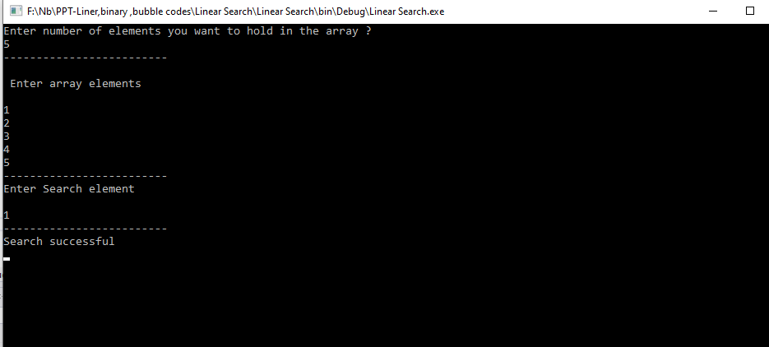
Output-Iteration 1 (Success)

Slide 7
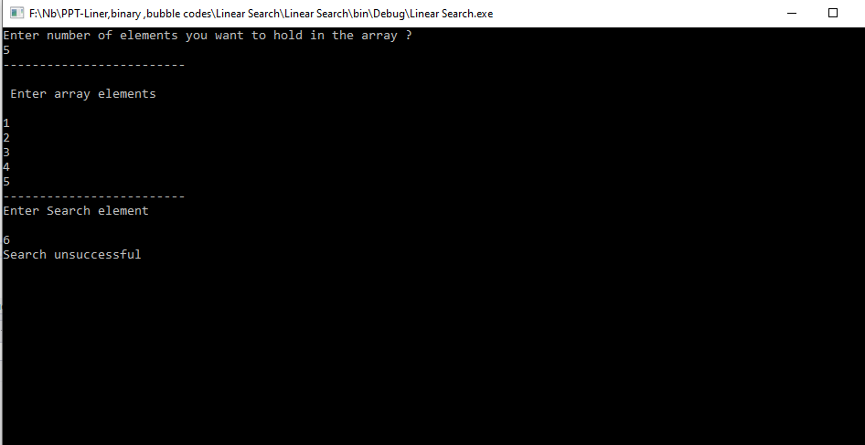
output-iteration 2(unsuccess)

Slide 8
Thank You

